Slide 1

WEBER COUNTY SHERIFF’S OFFICE
FARR WEST CITY
2013 QUARTERLY REPORT

Slide 2
CALL BREAKDOWN
 |  | REPORTS
CALL DESCRIPTIONS | TOTAL |  | CALL DESCRIPTION | TOTAL
911 calls | 4 |  | Motorist assist | 3
Abandoned vehicles | 1 |  | Ordinance violation | 1
Alarms | 6 |  | Parking problems | 3
Animal complaints | 16 |  | Premise checks | 13
Assaults | 0 |  | Property lost | 1
Assist other jurisdictions | 3 |  | Reckless drivers | 1
Burglaries | 1 |  | Sex offenses | 1
Citizen assists | 3 |  | Shoplifting | 2
Community policing | 25 |  | Suspicious person/vehicle | 5
Disturbance – family | 2 |  | Traffic violations | 1
Disturbance – juvenile | 1 |  | Telephone harassment | 1
DUIs | 1 |  | Thefts | 1
Fire department assists | 3 |  | Threatened suicide | 1
Frauds | 3 |  | Traffic accidents property | 18
Impounds | 2 |  | Traffic accidents injury | 1
Littering | 1 |  | Traffic stops | 41
Medicals | 11 |  | Tobacco violations | 1
Mental subjects | 1 |  | Vehicle burglaries | 0
Missing juvenile | 1 |  | Warrants | 4
Missing adult | 1 |  | Welfare checks | 2
JANUARY
290 CALLS
Priority 1 – 98
Priority 2 – 31
Priority 3 – 66
Priority 4 – 84
Priority 5 – 0
Priority 6 - 11

Slide 3
CALLS FOR SERVICE
5-YEAR COMPARISON
  TOTAL CALLS
  2009 225
  2010 248
  2011 235
  2012 249
  2013 290

Slide 4
CALL BREAKDOWN
 |  | REPORTS
CALL DESCRIPTIONS | TOTAL |  | CALL DESCRIPTION | TOTAL
911 calls | 3 |  | Parking problems | 3
Abandoned vehicles | 3 |  | Property damage | 1
Alarms | 4 |  | Premise checks | 18
Animal complaints | 10 |  | Property found | 1
Assaults | 1 |  | Protective order service | 1
Assist other jurisdictions | 3 |  | Runaway | 1
Burglaries | 0 |  | Sex offenses | 0
Citizen assists | 1 |  | Shots fired | 1
Community policing | 25 |  | Stalking | 1
Disorderly conduct | 1 |  | Suspicious person/vehicle | 6
Disturbance – family | 2 |  | Threats | 1
Disturbance – juvenile | 3 |  | Thefts | 0
DUIs | 1 |  | Threatened suicide | 1
Extra patrol | 1 |  | Traffic accidents property | 8
Frauds | 3 |  | Traffic accidents injury | 2
Impounds | 1 |  | Traffic stops | 49
Keep the peace | 1 |  | Till tap | 1
Liquor violation | 1 |  | Vehicle burglaries | 0
Medicals | 6 |  | VIN inspection | 1
Motorist assist | 5 |  | Warrants | 2
Neglect -child | 1 |  | Welfare checks | 1
FEBRUARY
240 calls
Priority 1 – 84
Priority 2 – 24
Priority 3 – 40
Priority 4 – 82
Priority 5 – 0
Priority 6 - 10

Slide 5
CALLS FOR SERVICE
5-YEAR COMPARISON
  TOTAL CALLS
  2009 180
  2010 230
  2011 194
  2012 231
  2013 240

Slide 6
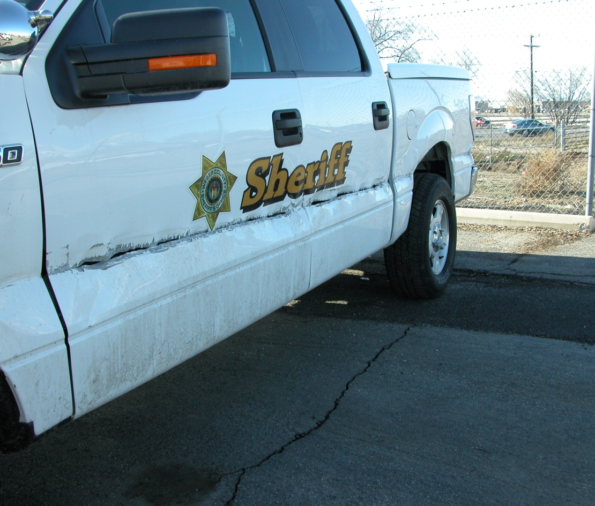
TRAFFIC ACCIDENTS
JANUARY
18 PD
1 PI
FEBRUARY
9 PD
2 Pi
Sheriff’s Office
7

Slide 7
CITATIONS 5-YEAR
COMPARISON

Slide 8
CALLS FOR SERVICE
5-year Comparison
  TOTAL CALLS
  2008 3018
  2009 2685
  2010 2899
  2011 2920
  2012 2847

Slide 9
2012 DUI ARRESTS

Slide 10
CRIME PATTERNS AND CONCERNS
Overall call volume has increased the first two months of 2013. This is not due to an increase in crime but rather an increase in community-oriented policing efforts which include school visits and business checks.
Overall, violent crime and property crime rates remain relatively low.
An increase in temperature usually correlates with an increase property crimes.
A crime prevention letter will be sent out with the city newsletter to remind residents to always lock their vehicles and to never leave valuables inside.

Slide 11
COMMUNITY POLICING
Crime prevention letter to be mailed out with city newsletter.

Slide 12
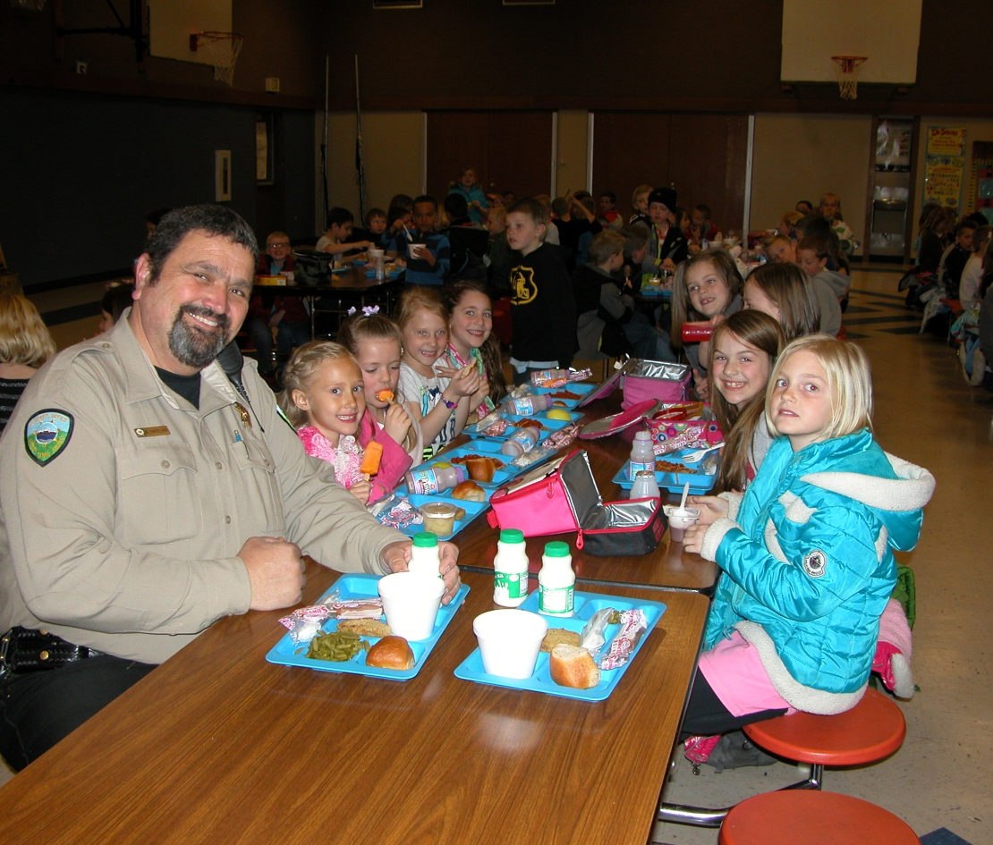
SCHOOL VISITS
Farr West Elementary
Jan - 14
Feb – 17
Wahlquist Jr. High
Jan – 1
Feb - 6
WELCOME SCHOOL RESOURCE
OFFICER MIKE CHATELAIN!

Slide 13
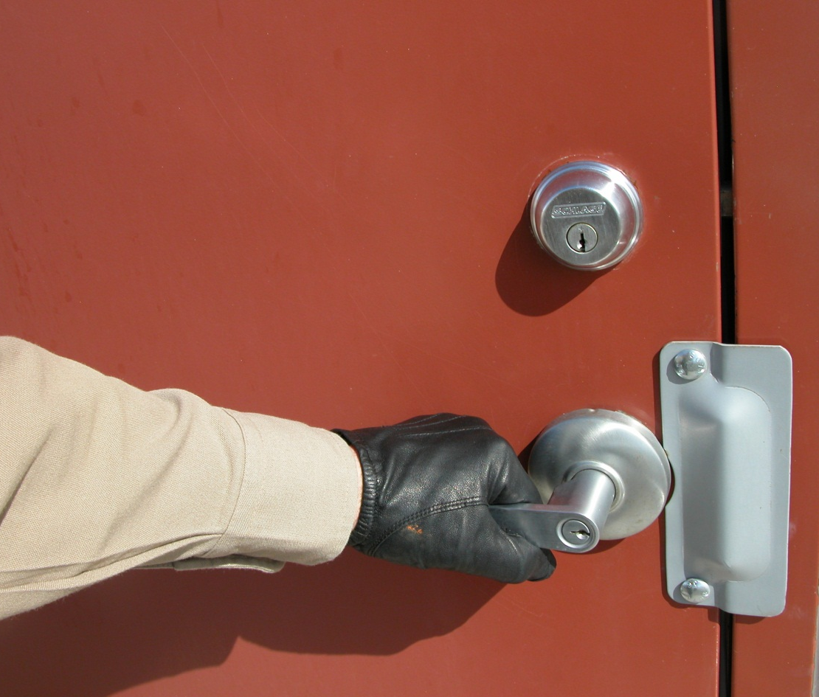
PREMISES CHECKS
JANUARY
17
February
22

Slide 14
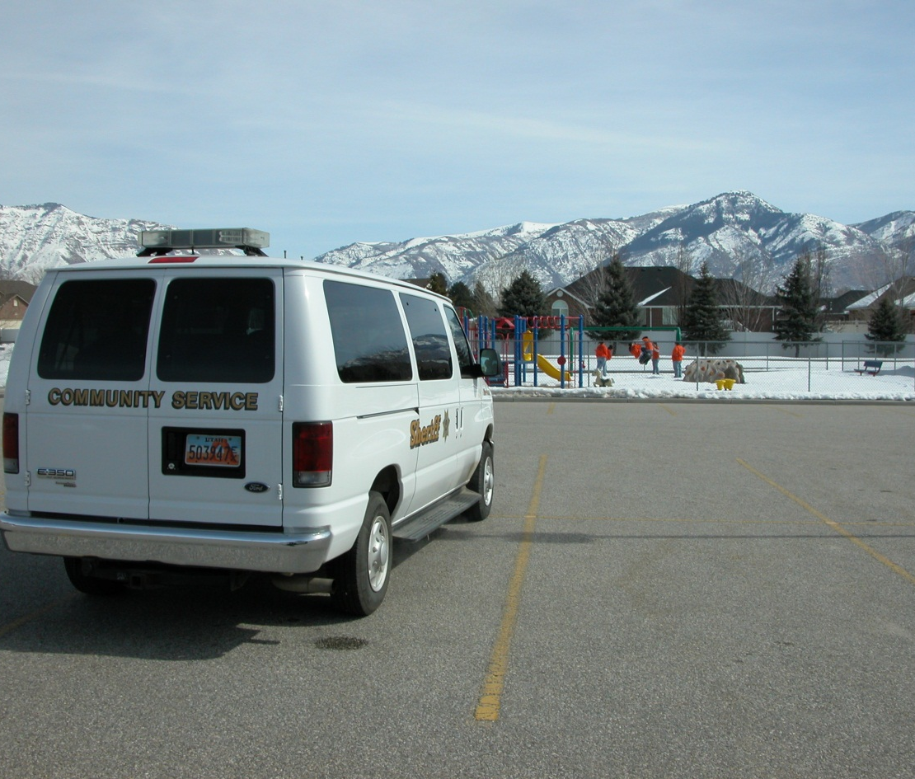
COMMUNITY SERVICE
On March 5th, a Sheriff’s Office Community Service Group spent the day cleaning up the area around the Farr West Office.

Slide 15
QUESTIONS?

